Slide 1
Attn: Instructor
Hello and welcome back! To help you kick off your first day, here are some tips to optimize this deck for your students.
Please edit these slides:
  Slide 9 – where students should register
  Slide 10 – add registration steps specific to your class
  Slide 21 – where students should purchase
See notes for slide commentary.
Check out this video from a Connect user to get tips on how to explain Connect to your students.
Have questions or need assistance for your first day of class? Contact your Learning Technology Representative. To find your rep, go here: www.mhhe.com/rep.
Lastly, have a great first day of class! And let us know how we can you help you!

Slide 2
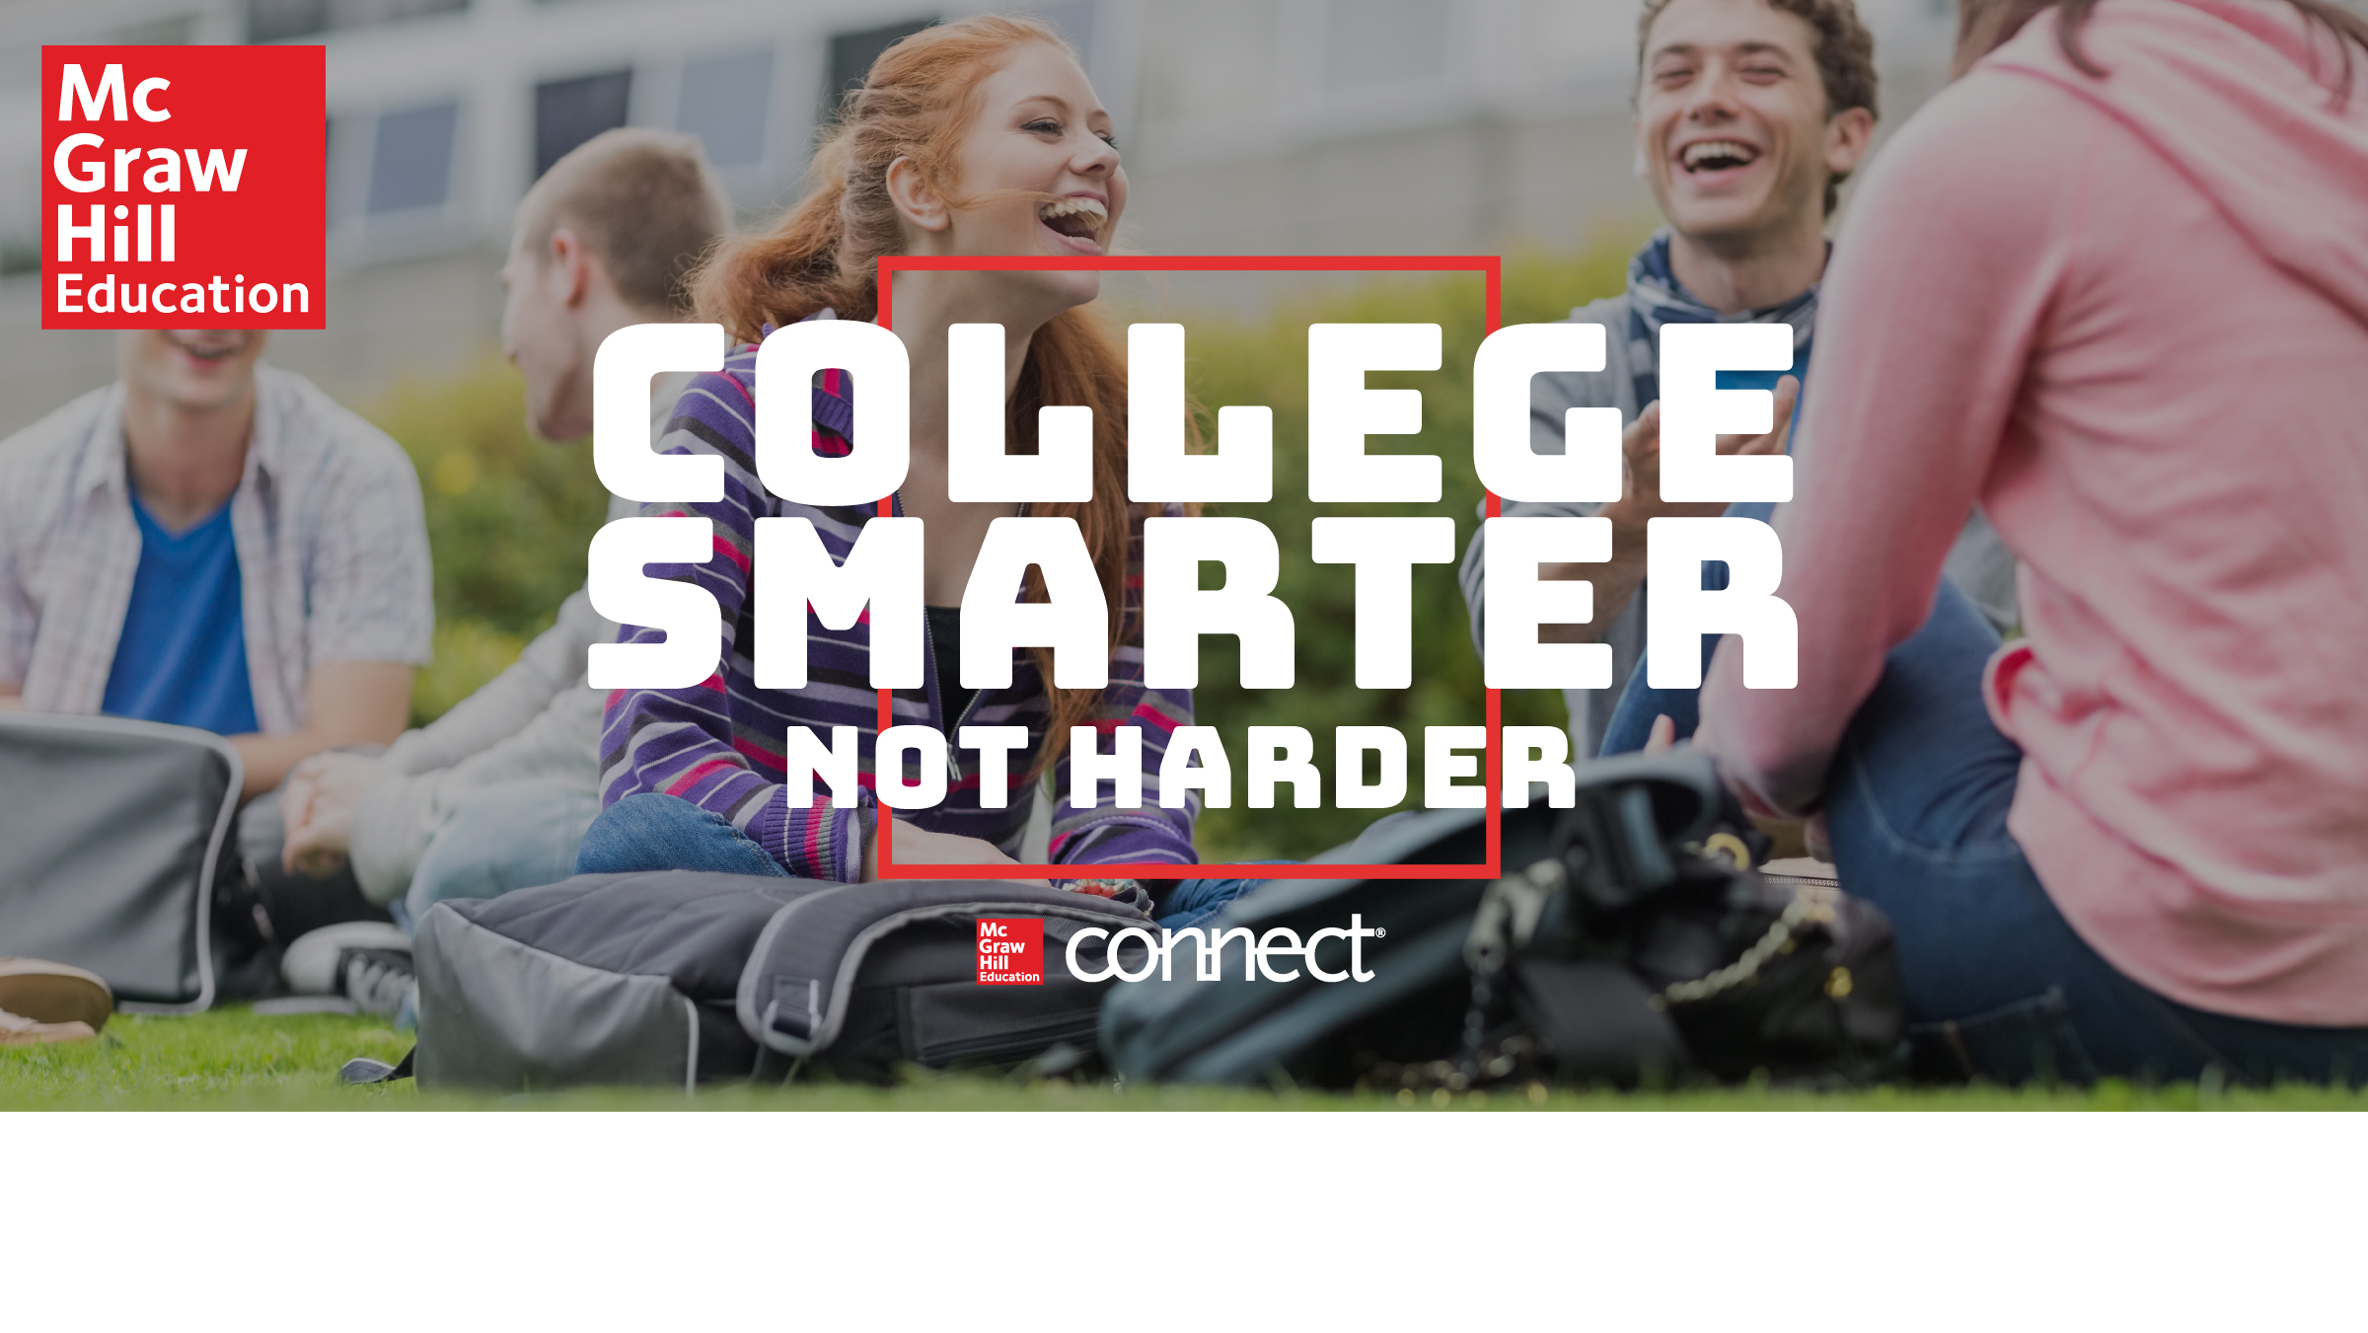
School Name | Course Name
Notes:
Hello Class.
Welcome back! I hope you are as excited about the new semester as I am. I wanted to take a few minutes to talk about the required course materials we’ll be using in this class.

Slide 3
How Connect Helps
Students College Smarter
Connect is your personalized digital learning assistant that makes acing exams, managing time, and getting work done easier — and more convenient — than ever.
Empowers you to learn your way, anytime, anywhere — fully digital, personalized
learning experience
Improves grades and likelihood of passing vs. traditional textbooks
Creates personalized study guides based on what you need to practice most
Highlights most important parts of your reading
Saves time and keeps you on track
Notes:
For this course, I have adopted an online personalized learning tool called Connect from McGraw-Hill.
Connect is like having your own digital tutor and personal planner at your fingertips, 24/7. Connect contains everything you need to pass this class – an eBook and other learning tools, your assignments, quizzes, and exams. And with to-do lists, calendars, and alerts, you can be sure you don’t miss an assignment, and ultimately get the grade you want and credits you need the first time around — no repeats, no added tuition costs. All for a fraction of the price of traditional textbooks.
Assignments in Connect account for ___% of your grade.

Slide 4
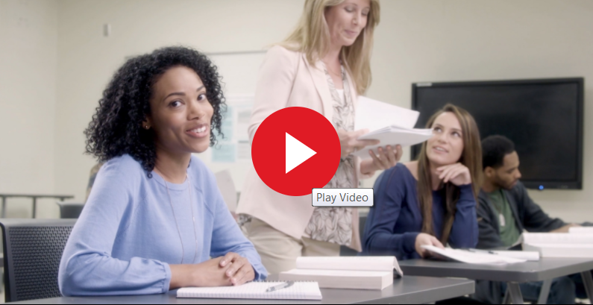
College Smarter From Day 1
If you have trouble playing video in presentation mode, click here to play in browser.
mhhe.com/collegesmarter

Slide 5
Connect Adaptive Technology
Like many other apps you love, Connect uses algorithms to personalize your learning.
Notes:
SmartBook (and LearnSmart) works much in the same way that Apps like Spotify and Pandora adapt to serve up music you like based on what it learns about you.
Connect includes an adaptive online version of the textbook called SmartBook, which highlights content for you so you can focus on what’s most important at any given point in time. As you complete your assignments, Connect adapts to what you know well, what you need help on, and how confident you feel. So you can save time, beat stress, and get ahead.

Slide 6
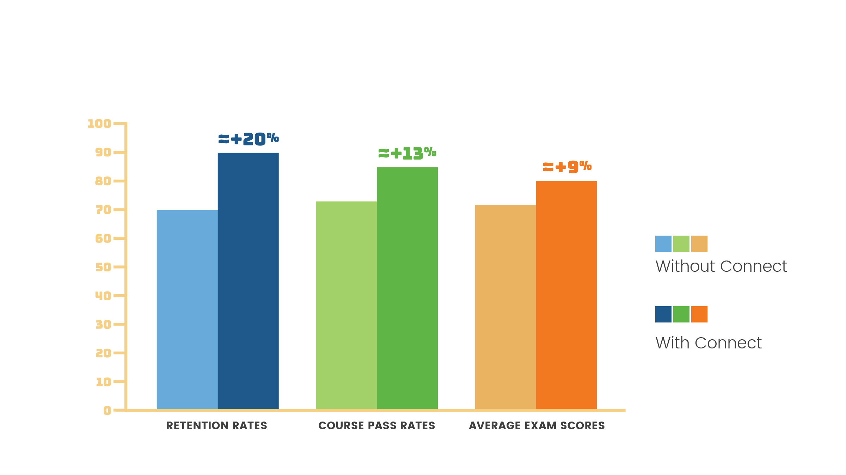
Connect Helps You Perform Better
Notes:
The learning tools within Connect have been proven to help students perform better in their classes. It’s a pedagogically sound way to organize your study time and give you an opportunity to engage in the material so you’re prepared for classroom discussions and for higher stakes assessments.
Over the course of a year, McGraw-Hill conducted a study across 16 different course sections at various colleges and universities and we found that students who used Connect performed significantly better than those who didn’t. Take a look at these numbers!
85.2% of students using Connect passed their course, compared with 72.5% of students not using Connect. Average exam scores rose almost 10% from 71% without Connect to 80.1% with Connect.

Slide 7
The Early Bird Gets the Grade
DAY 1:
DAY 7:
DAY 14:
Students who access
digital materials on
Day 1
Students who access
digital materials on
Day 7
Students who access
digital materials on
Day 14
AVERAGE SCORE:
AVERAGE SCORE:
AVERAGE SCORE:
81%
75%
70%
Notes:
McGraw-Hill’s research shows that students who have access to their course materials on the first day of class perform better in the class. They finish the course with an average assignment score of 81%, compared with students who wait a week and have an average assignment score of 75%, or those who wait two weeks and have an average assignment score of 70%.
Students who wait 3 weeks are at a substantially higher risk of failing the course!

Slide 8
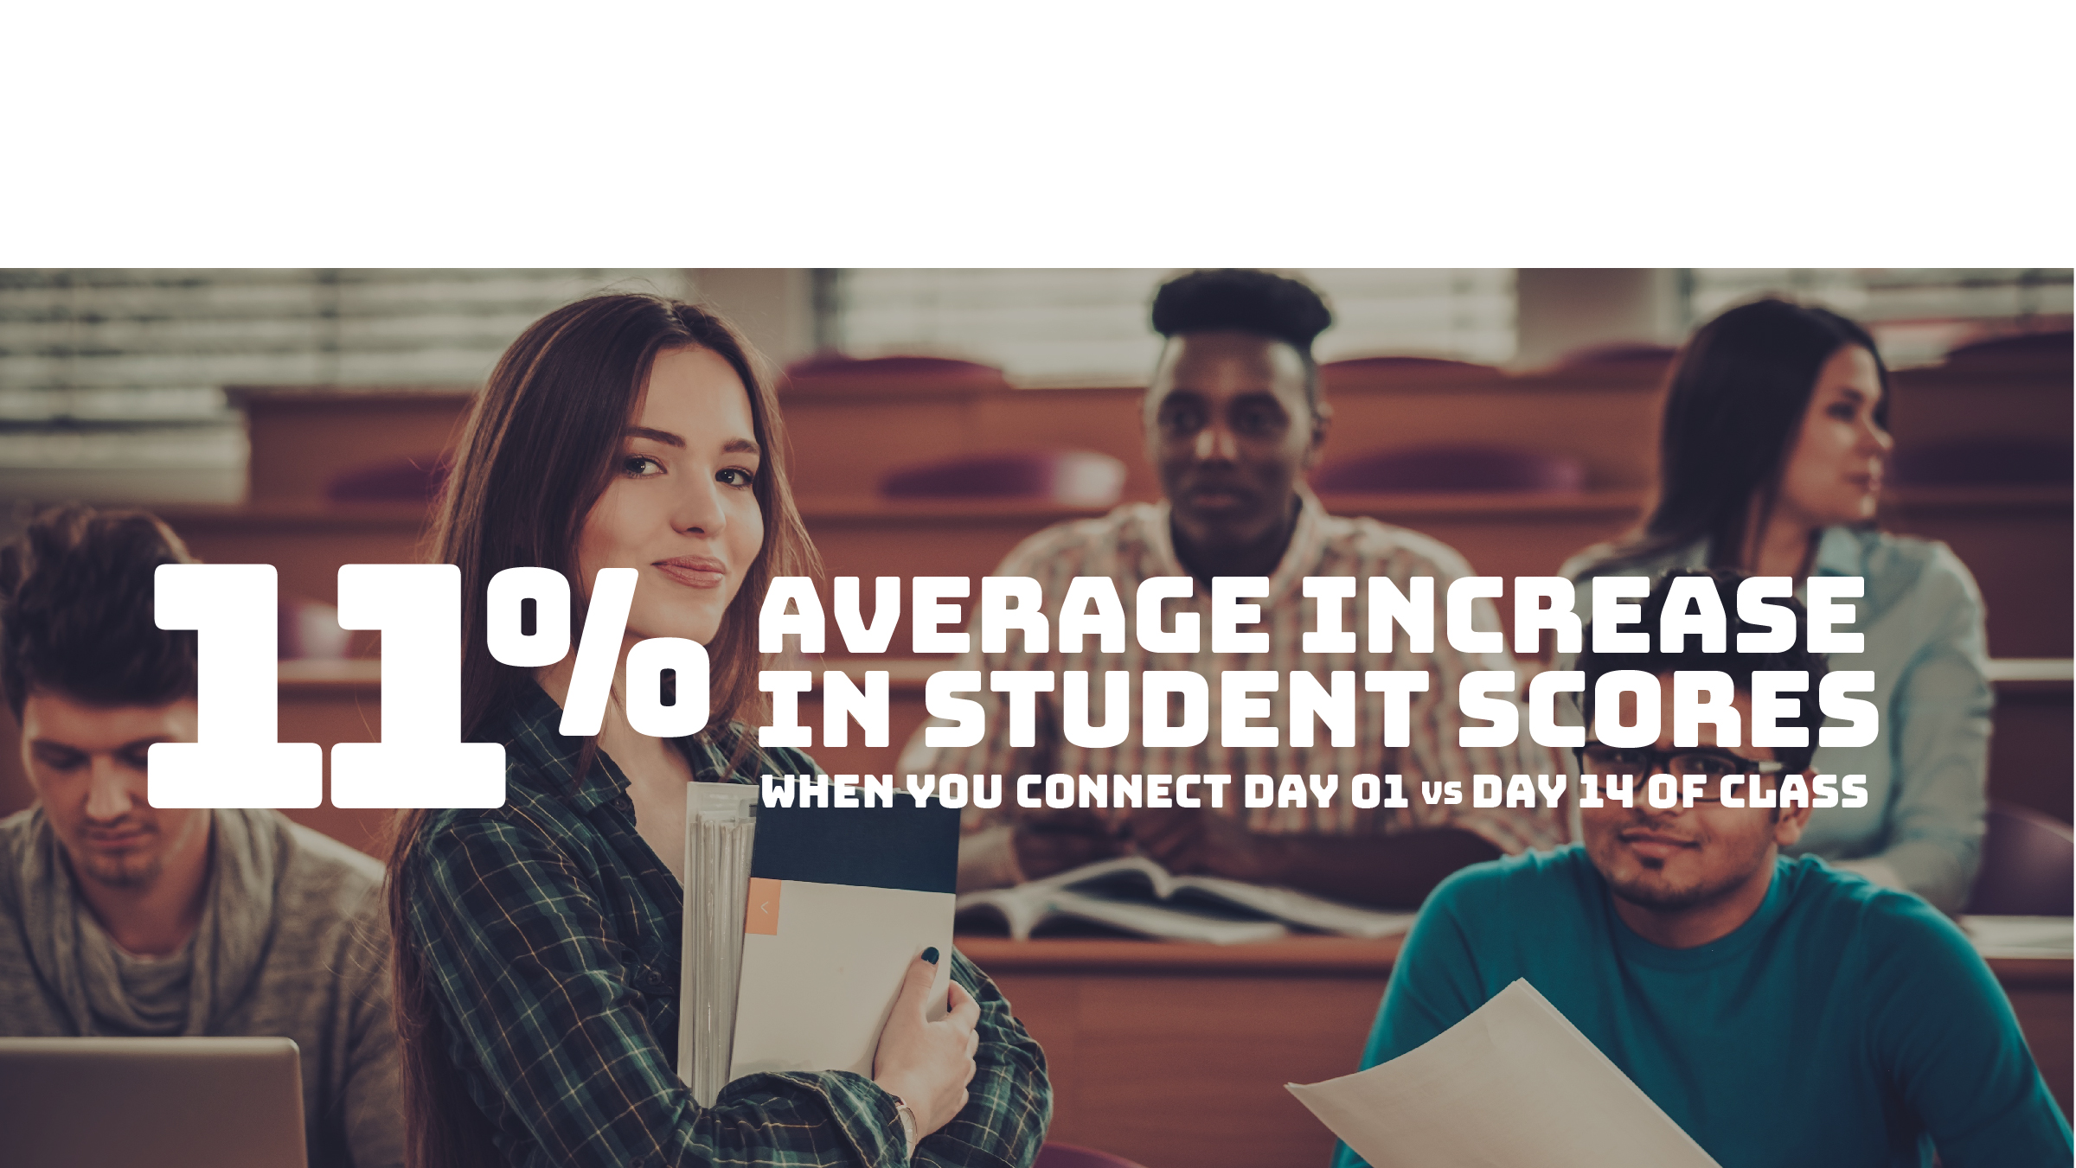
Don’t Wait — Activate
Notes:
By activating your access today, you are likely to finish the course with an 11% higher score!
With this in mind, let’s all pull out our phones, tablets, or laptops and register together right now!

Slide 9

Register for Connect Today
Go to this web address and enter your email to join the class.
[Paste course section URL here if not using LMS integration]
-OR-
[Enter your Learning Management System…students will be prompted to register after launching a Connect assignment]
Notes:
Tip: Ask a student to register live in class with their code or using the courtesy access. Then demo the course navigation. We recommend walking them through SmartBook to get started! Otherwise, you can log into your account, click on student view, and demo the course from the student perspective for your students.
We recommend students get registered in class – they can do so on the mobile device (horizontal view on Smartphones), tablet, or computer.
Slides 10 – 18 will help you explain SmartBook to your students offline, or you can demo live. If you don’t have SmartBook in your course, simply delete!

Slide 10

Registration Instructions
Notes for instructor:
To help students get started, we encourage you to have students register in class or show them how to register now.
Registration instructions vary by LMS integration and student Connect experience. If you are not familiar with your student registration steps to show your students, please go here to request a PowerPoint presentation including registration steps for your specific instance.
Tip: Ask a student to register live in class with their code or using the courtesy access. Then demo the course navigation.
Or, to walk through your course, you can log into your instructor account, click on student view, and show the student perspective for your students.

Slide 11
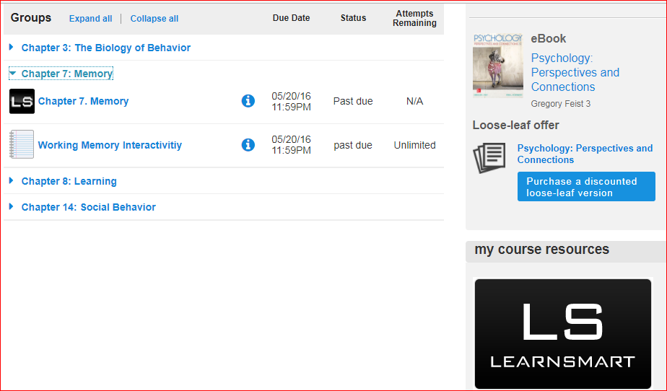
The adaptive difference: smartbook
Access your assigned materials in the Assignments list.
Notes:
Slides 10 – 18 will help you explain SmartBook to your students offline, or you can demo live. If you don’t have SmartBook in your course, simply delete!
Let’s take a look at a SmartBook assignment. We can launch an assignment from the list of assignment

Slide 12
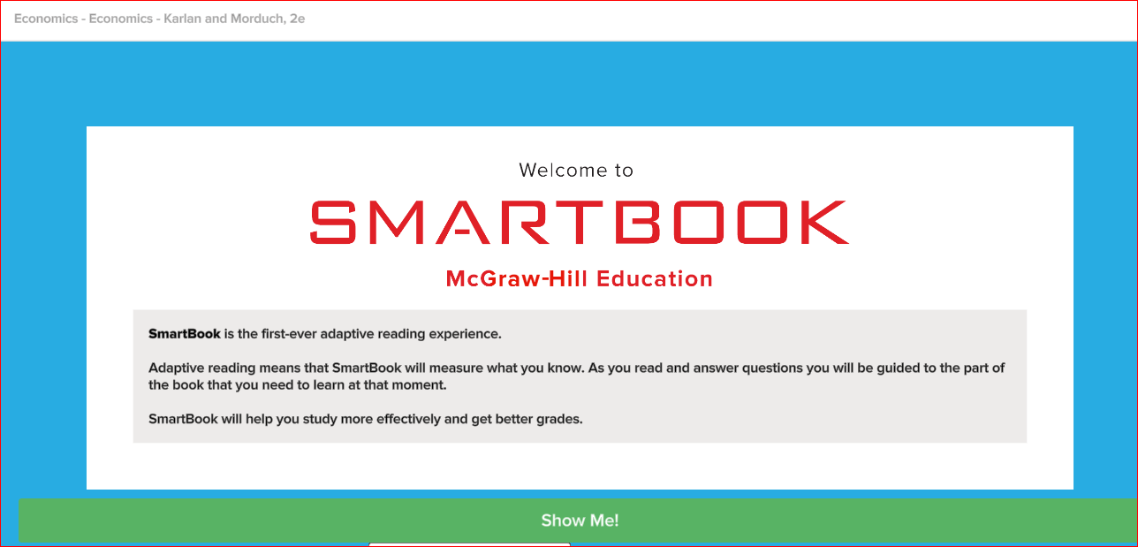
The adaptive difference: smartbook
The first time you launch a SmartBook assignment, you will be presented with a brief tutorial that explains how SmartBook works.
Notes:
The first time we launch SmartBook, we will see a brief tutorial that explains how SmartBook works.

Slide 13
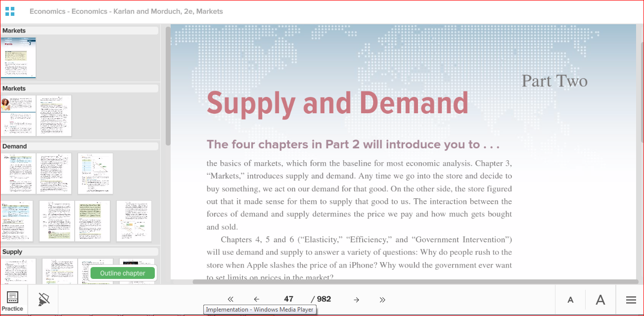
The adaptive difference: smartbook
When you open a chapter, you’ll see a Preview Pane outlining the chapter. You can close this by clicking on the 4-squares icon on the upper left corner.
Notes:
The first time we enter a chapter, we’re taken to the first page of the chapter and we can view an outline of the chapter in the pane on the left-hand side.
If you want to preview the outline of the chapter, you’ll see what you are about to read. You can also close this pane by clicking on the 4 squares in the upper left corner.

Slide 14
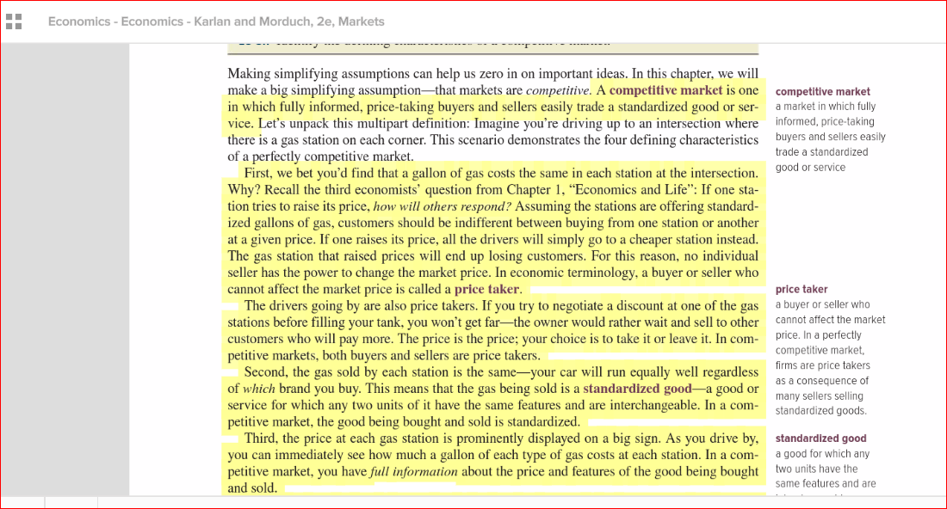
The adaptive difference: smartbook
Content in the chapter will be highlighted in yellow to indicate the content that is most important to focus on at any moment in time
Notes:
You’ll see that portions of the chapter are highlighted in yellow; this is the content that is most important for you to read at this moment in time. To save time, you can focus on reading just the highlighted portions in the chapter, which will change over time as you work through the chapter.

Slide 15
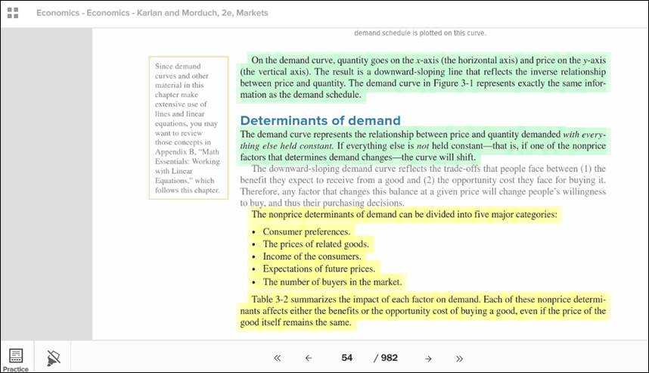
The Adaptive Difference: SmartBook
Notes:
After you spend a little time reading, you’ll see the “Practice” icon in the bottom left corner start to flash, telling you it’s time to jump into the “Practice” phase, where you will answer questions about what you just read about to help reinforce what you learned and to help you retain it. When you answer questions correctly, the highlights turn from yellow to green to indicate that you have learned that material.
Your goal is for all of the highlights in the chapter to be green, showing you that you have mastered the material.

Slide 16
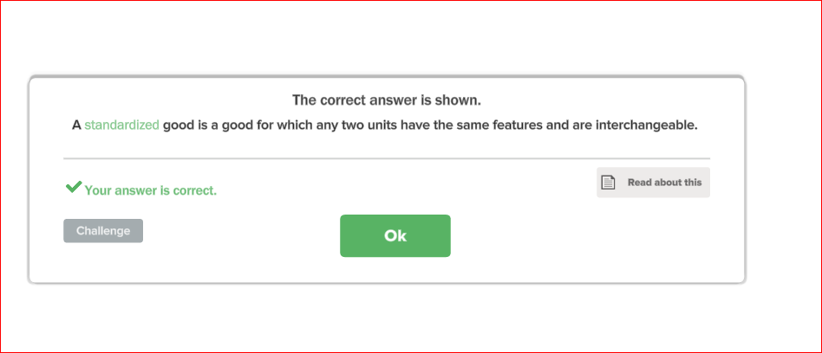
The Adaptive Difference: SmartBook
Notes:
You will be see various types of questions – multiple choice, fill in the blank, etc., and you are supposed to answer the question and then choose how confident you are that you know the right answer. If you are confident, choose “I know it”; if not, select one of the other options. You can also click “Read about this” if you are unsure, and you will be taken to the portion of the chapter where this topic is discussed.
After you answer and select your confidence level, click “OK” and you’ll immediately see if you were correct or incorrect.

Slide 17
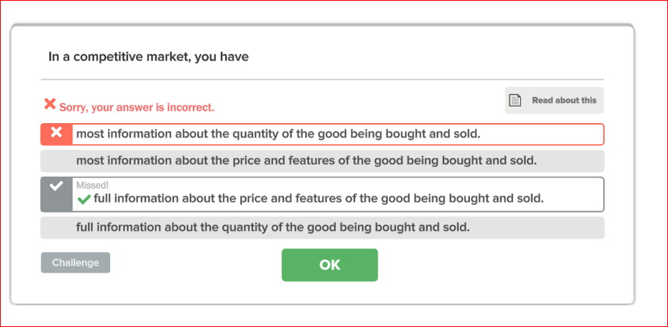
The Adaptive Difference: SmartBook
Notes:
If you answer a question incorrectly, you will sometimes see feedback on why you were wrong.
Unlike a test or quiz, you are not penalized if you answer incorrectly; the goal of SmartBook is to help you learn. It was designed with your success in mind!

Slide 18
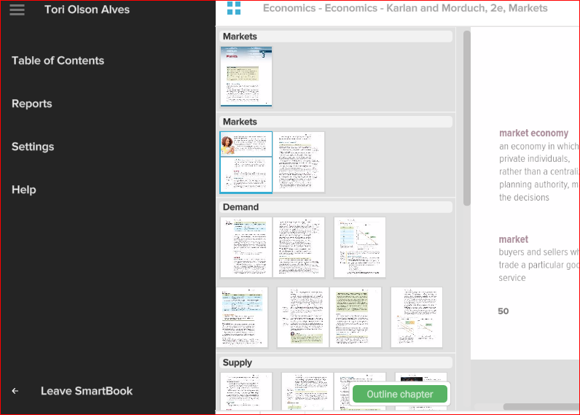
The Adaptive Difference: SmartBook
Notes:
You can complete the SmartBook assignment, or exit out of it by opening the menu on the left hand side of the screen, and clicking on “Leave SmartBook”.
When you come back to it later, you will pick up where you left off.

Slide 19
Return to course home
Notes:
You will return to your course home page and you will see all of the assignments that are available to you. All assignments account for ___% of your grade.
You may see links for videos, homework assignments, quizzes, and tests.

Slide 20
We Have You Covered.
Where to Go For Help:
TECH SUPPORT & FAQ:
CALL: (800) 331-5094
EMAIL & CHAT: mhhe.com/support
MONDAY-THURSDAY: 24 hours
FRIDAY: 12 am - 9 pm EST
SATURDAY: 10 am - 8 pm EST
SUNDAY: 12 pm – 12 am EST
FIND MORE SUPPORT:
connectstudentsuccess.com
FIND MORE TIPS:
mhhe.com/collegesmarter
Help Tips: WATCH VIDEO
NOTE: If you contact your instructor with a technical question, you will be asked to provide a case number from tech support before your concern is escalated.
Notes:
I’d like to make sure you know where to go for help if you need it.
Should you have questions about anything of a technical nature while you are registering or once you are in Connect, you can contact McGraw-Hill’s Customer Experience Group. They are available 24 hours a day Monday through Thursday, and they have extensive hours on the weekends as well. You can call, chat, complete an online web form, or access their online Knowledge Base to find an answer for yourself.

Slide 21
Purchase Options
OPTION 1:
CONNECT + TEXT PACKAGE
OPTION 2:
GO ALL DIGITAL
WITH CONNECT
The bookstore is carrying a bundle that includes the text and a printed Connect access code at a discounted price
for you.
For this course we will be using McGraw-Hill Connect. Connect includes everything you need for this course, including [Smartbook and
the eBook].
Notes:
You have options on how to best obtain the required course materials.
There is a package in your bookstore that has been discounted to save you money, or you can choose to purchase access to Connect only, which includes all of the course materials – including SmartBook [and our New eBook] if you want a completely online experience.

Slide 22
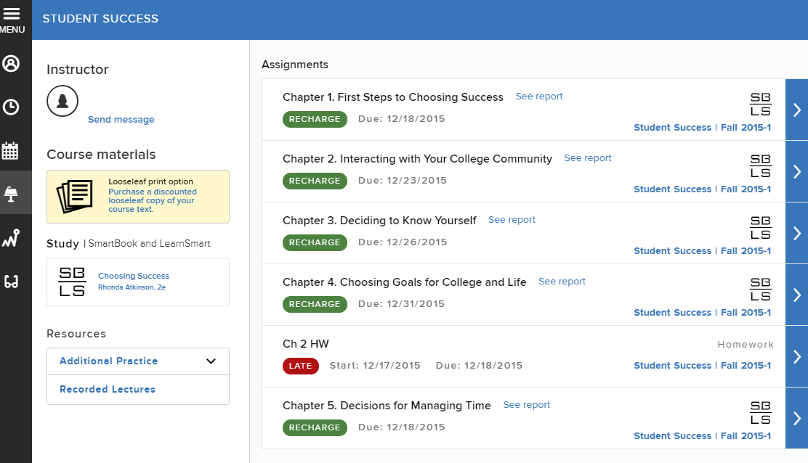
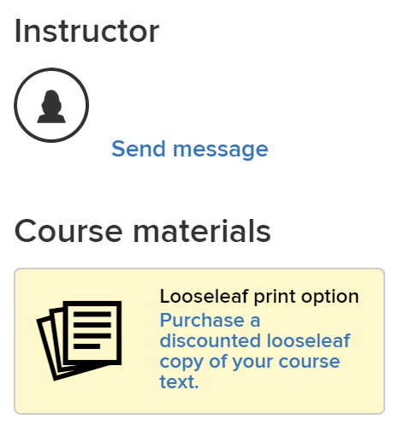
Save With loose-leaf
Notes:
If you choose to go with the all-digital, Connect-only option, any time after you purchase access to Connect you will have an option to purchase a Loose Leaf version of the book at a discounted price – right from within your Connect course.

Slide 23

5-Day Checklist
In just 5 days, you’ll master the art of College Smarter, Not Harder:
Register and log in to your Connect course
Enter our #ShowUsYourActivation sweepstakes for a chance to win cash and other prizes: bit.ly/showyouractivation
Hear from students on the latest tricks to studying smarter, not harder with Connect at: bit.ly/connectgetstarted
COLLEGE EVEN SMARTER — make the most of your time and budget — with our latest tips to surviving college at: bit.ly/mhillhacks
Ace your exams! Check out these easy study activities you can complete in less than 10 minutes at: bit.ly/10MHHE
*SmartBook is not available for all classes
Notes:
McGraw-Hill, is invested in student success and they want you to succeed in this course! There are numerous resources they’ve developed to help you get the most out of Connect.
They created a ‘College Smarter, Not Harder’ website that contains useful videos to help you register and get familiar with Connect. There are also student testimonials as well as links to sign up for student-led webinars that will help you succeed. They will also send timely reminders throughout the semester, highlighting what’s most important at that time.

Slide 24
BECOME A STUDENT AMBASSADOR
LEARN. Grow your network and gain leadership experience
COLLABORATE. Partner with your MHE sales team to drive digital awareness
on your campus
BUILD YOUR personalized BRAND. Hone your skills in public speaking,
problem solving, and creativity by interacting with faculty, students, and MHE executives
MAKE AN IMPACT. Work directly with MHE to assist in product development and be
part of the future of digital education
Learn more: www.mhheambassadors.com
Notes:
McGraw-Hill Student Ambassadors are students like you from around the country who have been successful using learning tools and resources, like Connect, provided by McGraw-Hill Education and are eager to help their fellow classmates do the same.
They connect with educators and students around campus to share best practices, how-to’s, and study success tips.
This program offers Student Ambassadors valuable real-world skills while empowering them to make a positive impact within their communities.
McGraw-Hill is growing this team of Ambassadors so go to their website if you’re interested in learning more.

Slide 25
Connect with mcgraw-hill education
@MHHIGHERED
YOUTUBE.COM/MHHIGHERED
@MHESTUDENTS
SMS MESSAGING
@MHEDUCATION
Notes:
We invite you to connect with McGraw-Hill through various social media channels to stay informed and to help you get the most out of Connect.
You can opt-in to SMS messaging to receive text message tips and information from McGraw-Hill.

Slide 26
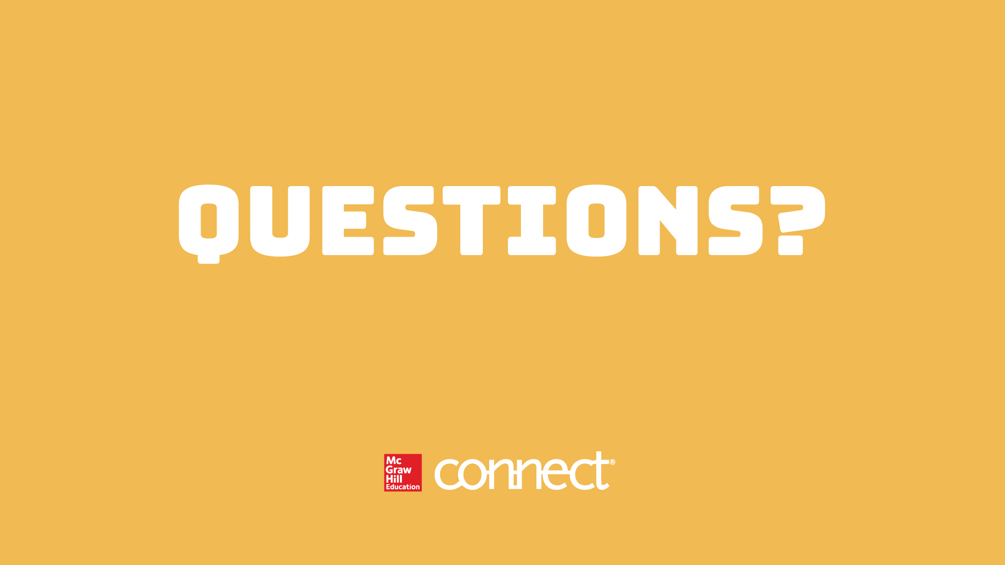
mhhe.com/collegesmarter

